Slide 1

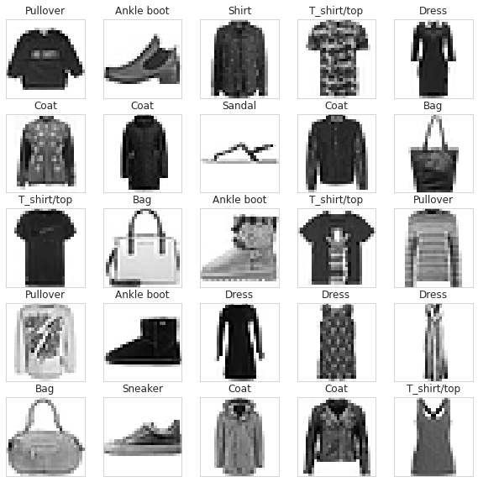


Fashion
Campus
By 7 Musketeers Team

Slide 2

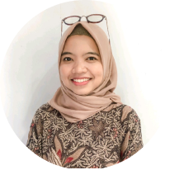

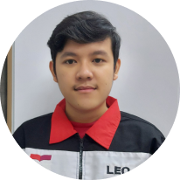
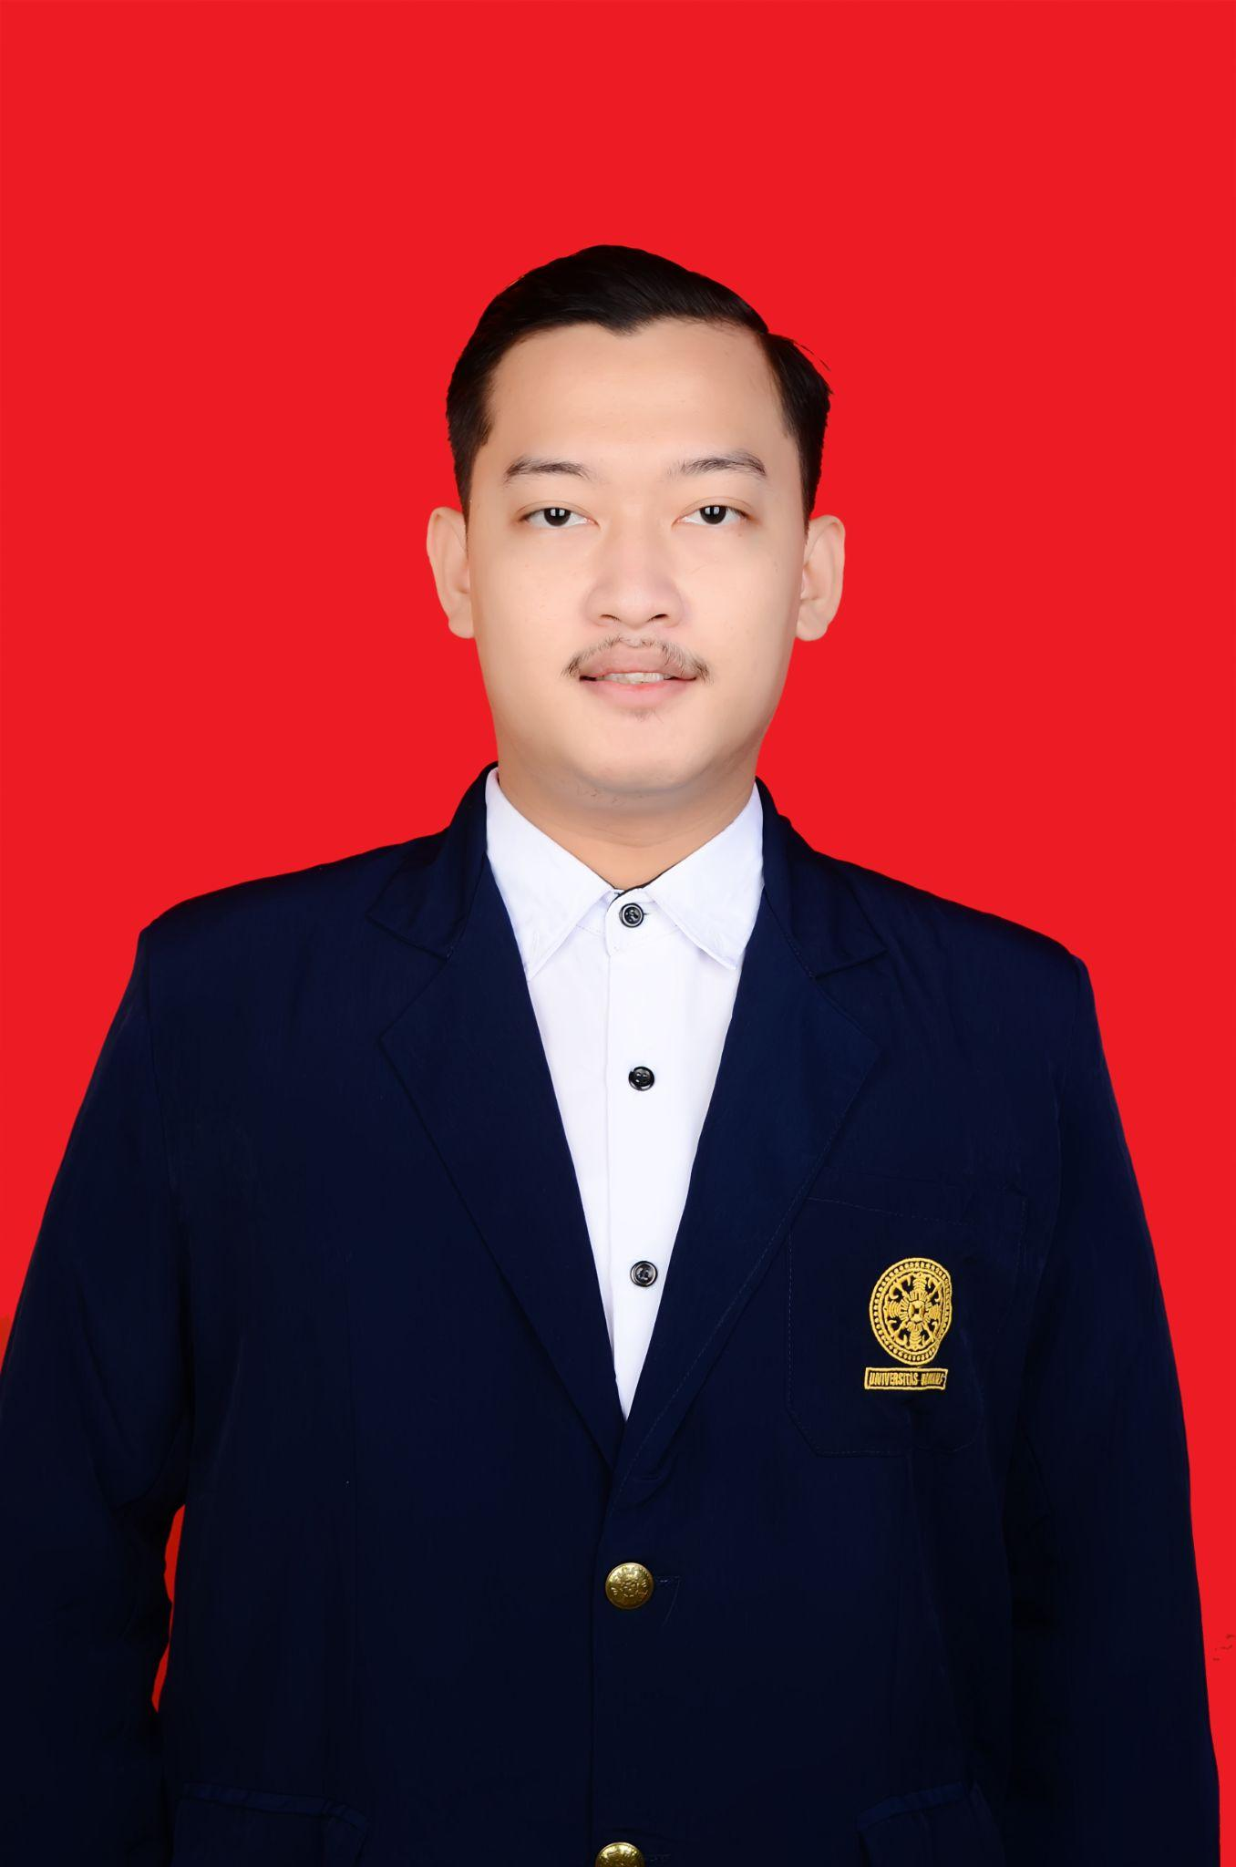
Our Mentor
and Facil
Aries Fitriawan
Mentor
Lilis Indah R.
Facilitator
Our
Team
I Wayan Adi Saputra
Universitas Prasetiya Mulya
Leo Tirto Purnomo
Universitas Telkom
Ilham Habibullah
Universitas Udayana

Slide 3
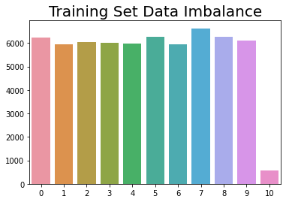


OVERVIEW
Tools:
Dataset
Notes:
We collect the datasets from <source>
We prepare the dataset collected by labelling using LabelImg
We chose this pre-trained model zoo because it has good ratio of detection speed and accuracy. Because we planned it to be a video stream, thus speed is important
We used one of the latest version of tensorflow, tensorflow 2.4.0

Slide 4
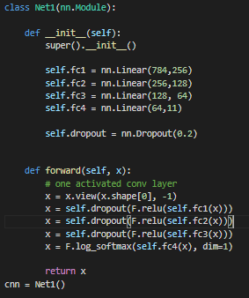
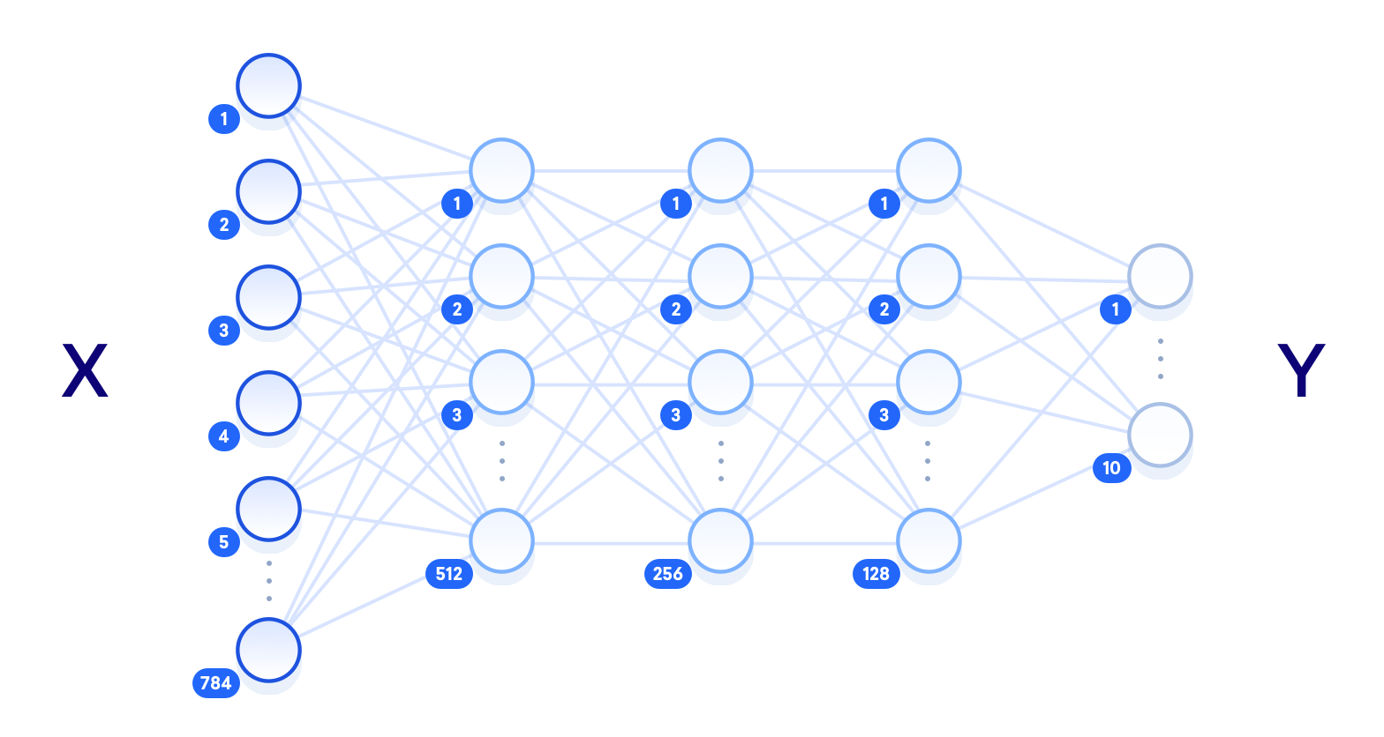

AI – Network Model
Berikut merupakan model yang digunakan:
11
256
64
Notes:
We collect the datasets from <source>
We prepare the dataset collected by labelling using LabelImg
We chose this pre-trained model zoo because it has good ratio of detection speed and accuracy. Because we planned it to be a video stream, thus speed is important
We used one of the latest version of tensorflow, tensorflow 2.4.0

Slide 5
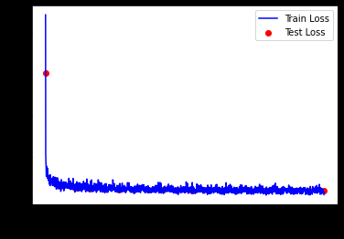
AI – Network Model Loss
Notes:
We collect the datasets from <source>
We prepare the dataset collected by labelling using LabelImg
We chose this pre-trained model zoo because it has good ratio of detection speed and accuracy. Because we planned it to be a video stream, thus speed is important
We used one of the latest version of tensorflow, tensorflow 2.4.0

Slide 6
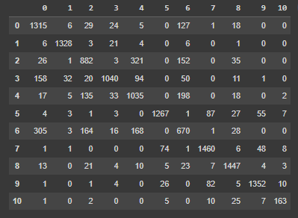
Confusion Matrix
Pada bagian AI total tingkat akurasi keseluruhannya yaitu 88%. Dengan confussion matrix seperti gambar berikut:
11
Notes:
We collect the datasets from <source>
We prepare the dataset collected by labelling using LabelImg
We chose this pre-trained model zoo because it has good ratio of detection speed and accuracy. Because we planned it to be a video stream, thus speed is important
We used one of the latest version of tensorflow, tensorflow 2.4.0

Slide 7

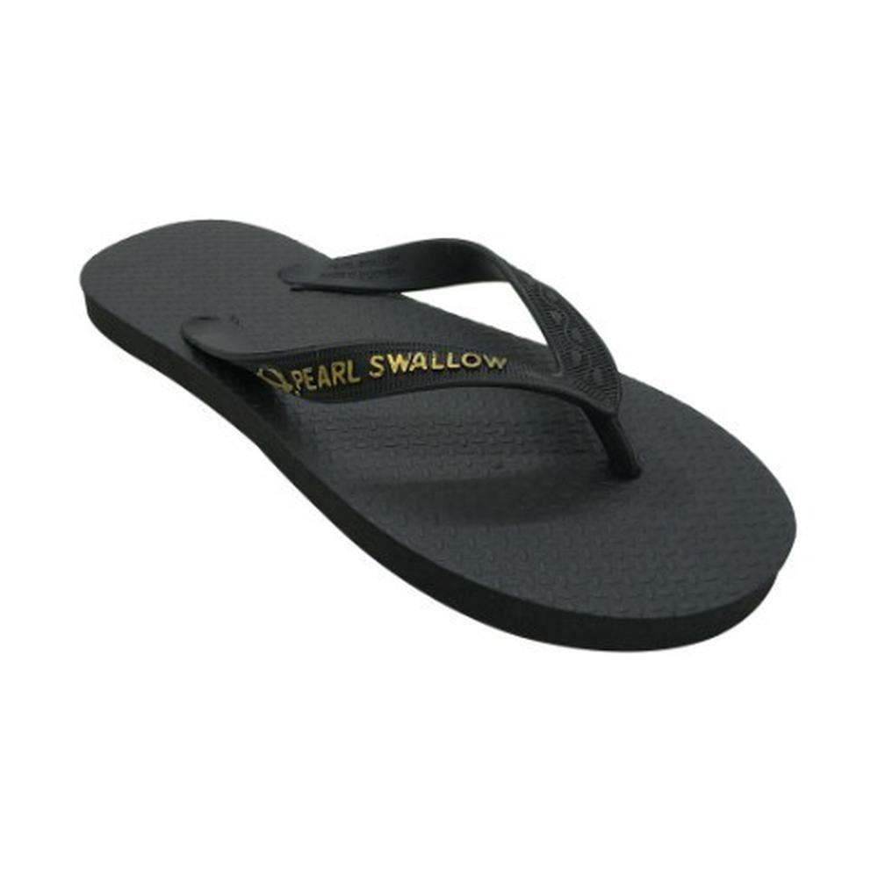
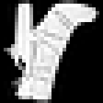
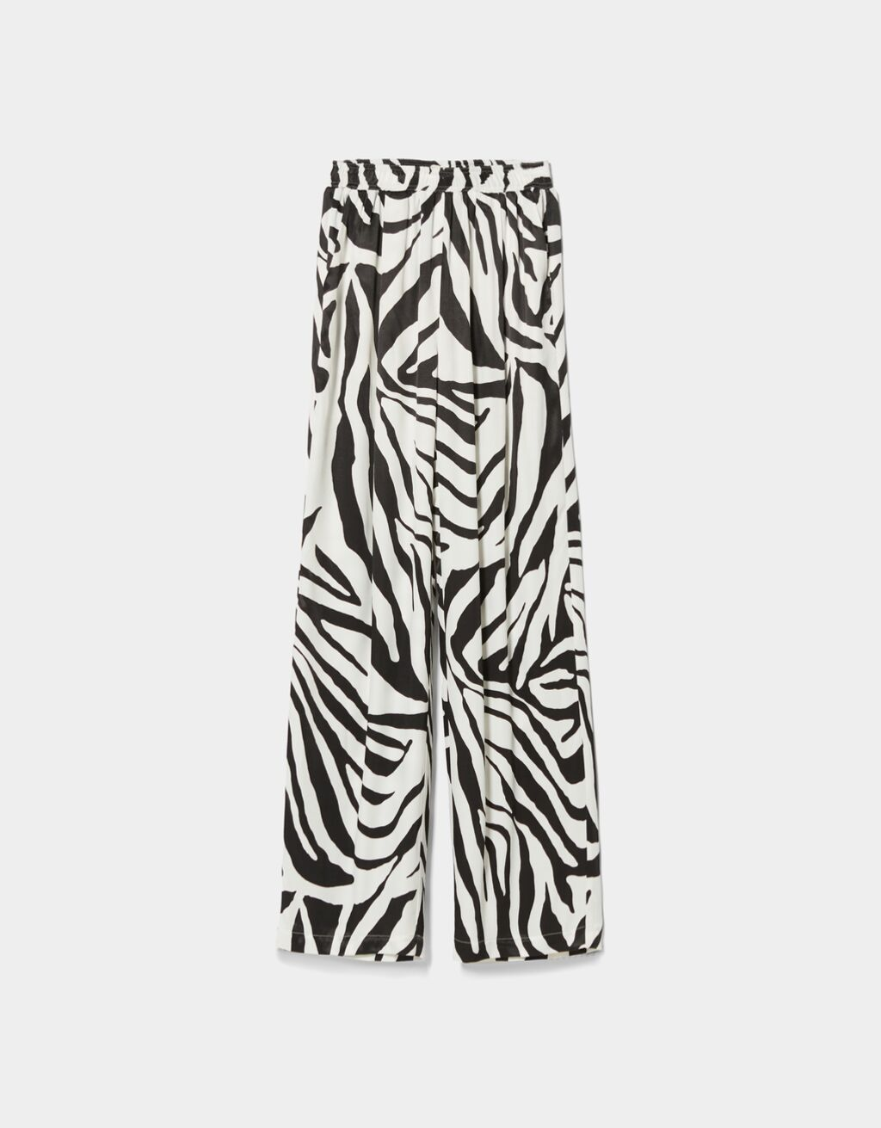
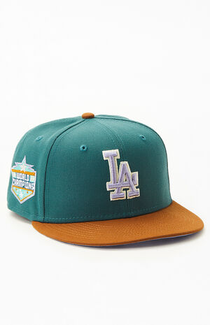
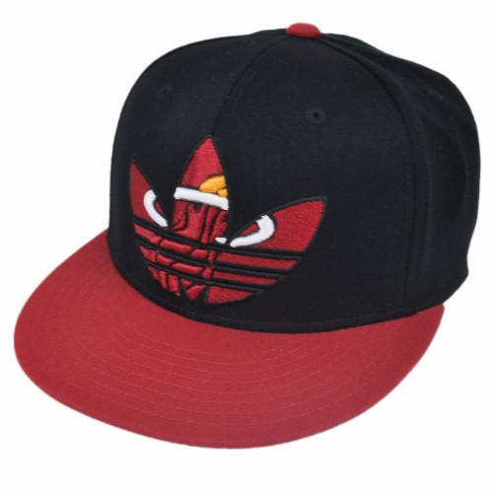
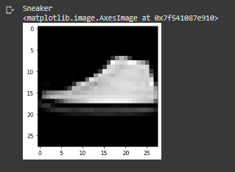
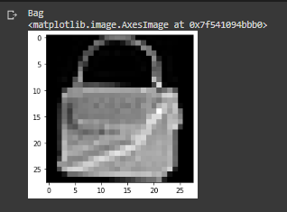
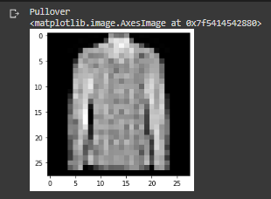
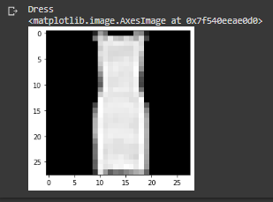
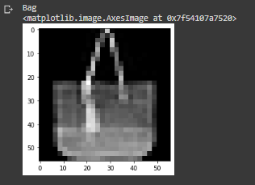
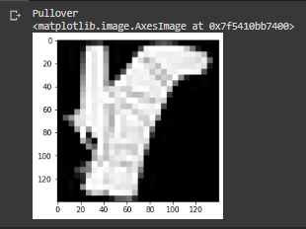
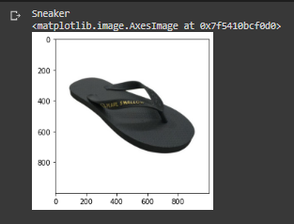
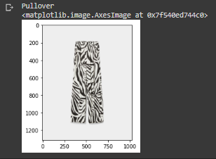
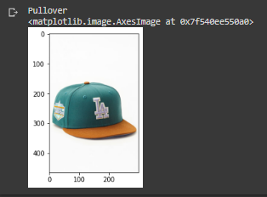
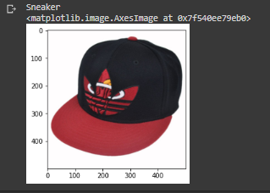
AI – Jury Test
Notes:
We collect the datasets from <source>
We prepare the dataset collected by labelling using LabelImg
We chose this pre-trained model zoo because it has good ratio of detection speed and accuracy. Because we planned it to be a video stream, thus speed is important
We used one of the latest version of tensorflow, tensorflow 2.4.0

Slide 8
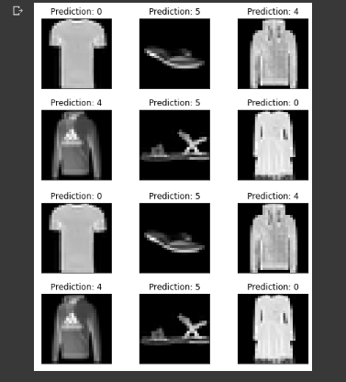
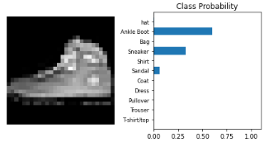
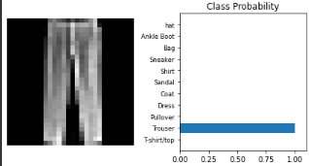
Control From MNIST Test
Notes:
We collect the datasets from <source>
We prepare the dataset collected by labelling using LabelImg
We chose this pre-trained model zoo because it has good ratio of detection speed and accuracy. Because we planned it to be a video stream, thus speed is important
We used one of the latest version of tensorflow, tensorflow 2.4.0

Slide 9
Summary AI
Total Accuracy Percentage: 88%
What is need to be improved ?
Perbanyak dataset
Lebih mensortir kembali dataset yang akan digunakan
Penerapan Data Augmentasi
Link Google Collab:
https://colab.research.google.com/drive/1BFIStV9q2gRWebFv4qZ6BGPGSU-VF6Wg?usp=sharing

Slide 10
Thank You ^^

